Slide 1
MALLA REDDY UNIVERSITY
MR22-1CS0146: OBJECT ORIENTED SOFTWARE ENGINEERING
II Year B.Tech. CSE I - Sem
(MRU-R22)
UNIT-I

Slide 2
Introduction to Software Engineering:
A generic view of Process: Software Engineering, Process Framework, CMM Process Patterns and Process Assessment.
Process Models:
Prescriptive Models, Waterfall Model, Incremental Process Models, Evolutionary Process Models, Specialized Process Models, The Unified Models, Personal And Team Process Models, Process Technology, Product And Process.

Slide 3
DAY-1

Slide 4
INTRODUCTION TO SOFTWARE ENGINEERING
Software:
Collection of integrated programs.
Carefully-organized instructions that provide desired features, function, and performance, when executed.
Computer program and related documentation such as requirements, design models and user manuals.
Characteristics of Software:
Software is developed or engineered; it is not manufactured in the classical sense.
Software does not “wear out” (not susceptible to environment effects).
Reusability of components.
Flexibility of software.
Maintainability of software.
Reliability of Software

Slide 5
Engineering:
Application of scientific and practical knowledge to invent, design, build, maintain, and improve frameworks, processes, etc.
Software Engineering:
The systematic, disciplined quantifiable approach to the development, operation and maintenance of software.
includes activities to manage the project, develop tools, methods and theories that support the software production.
provides a standard procedure to design and develop a software.

Slide 6
A GENERIC VIEW OF PROCESS
SOFTWARE ENGINEERING - A LAYERED TECHNOLOGY:
The bedrock that supports software engineering is a quality focus.
The foundation for software engineering is the process layer.
Software engineering methods rely on a set of basic principles that govern area of the technology and include modeling activities.
Software engineering tools provide automated or semi-automated support for the process and the methods.

Slide 7
A PROCESS FRAMEWORK:
A process defines who is doing what, when, and how to reach a certain goal.
A Process Framework establishes the foundation for a complete software process
Identifies a small number of framework activities also, set of umbrella activities
Each framework activity has set of s/w engineering actions.
Each s/w engineering action (e.g., design) has collection of related tasks (called task sets):
work tasks
work products (deliverables)
quality assurance points
project milestones.

Slide 9
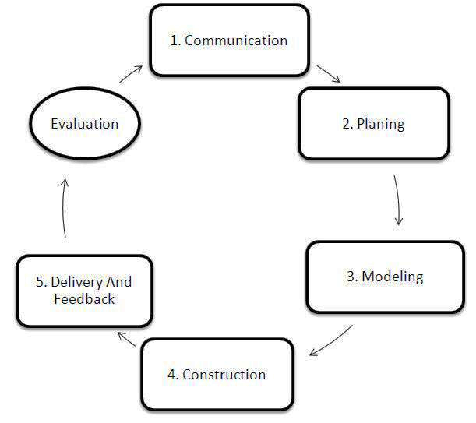
Generic Process Framework:
It is applicable to the vast majority of software projects.
These 5 generic framework activities can be used during the development of small programs, the creation of large web applications, and for the engineering of large, complex computer-based systems.

Slide 10
Communication:
Involves communication and collaboration with the customer and encompasses requirements gathering and other related activities.
Planning:
Establishes a plan for the software engineering work that follows. It describes the technical tasks to be conducted, the risks that are likely, the resources that will be required, the work products to be produced, and a work schedule.
Modeling:
Encompasses the creation of models that allow the developer and customer to better understand software requirements
The modeling activity is composed of 2 software engineering actions- analysis and design.
Analysis encompasses a set of work tasks.
Design encompasses work tasks that create a design model.
Construction:
Combines core generation and the testing that is required to uncover the errors in the code.
Deployment:
The software is delivered to the customer who evaluates the delivered product and provides feedback based on the evolution.

Slide 11
The following are the set of Umbrella Activities.
Software project tracking and control
Assess progress against the project plan and take necessary action to maintain schedule.
Risk Management
Assesses risks that may effect the outcome of the project or the quality of the product.
Software Quality Assurance
Defines and conducts the activities required to ensure software quality.
Formal Technical Reviews
Assesses software engineering work products in an effort to uncover and remove errors.
Measurement
Define and collects process, project and product measures that assist the team in delivering software that needs customer’s needs
Software configuration management
Manages the effects of change throughout the software process.
Reusability management
Defines criteria for work product reuse and establishes mechanisms to achieve reusable components.
Work Product preparation and production
Encompasses the activities required to create work products such as models, document, logs, forms and lists.

Slide 12
DAY-2

Slide 13
THE CAPABILITY MATURITY MODEL INTEGRATION (CMMI):
The Capability Maturity Model Integration (CMMI) is a model that aids in identifying the strengths and weaknesses of an organization’s current processes and shows the way to improvement. CMMI’s primary goal is to create high-quality software.
The CMMI represents a process meta-model in two different ways:
As a continuous model
As a staged model.
Each process area is formally assessed and is rated according to the following capability levels.
Level 0: Incomplete
Level 1: Performed
Level 2: Managed
Level 3: Defined
Level 4: Quantitatively managed
Level 5: Optimized
The CMMI defines each process area in terms of “specific goals” and the “specific practices” required to achieve these goals.

Slide 14
1. Initial Level
The processes at this CMMI level tend to be erratic and reactive. The organization is at its worst at this point due to the unpredictability of the environment and the likelihood of errors and ineptitude.
2. Managed processes
At maturity level #2, an organization has completed all the process areas’ specialized and general goals. In other words, the organization’s initiatives have ensured that processes are planned, carried out, measured, and controlled.
3. Defined processes
Organizations take a more preventative approach than a reactive one at this level.
Managers are now aware of the flaws and how to fix them to enhance their operations. There are several Key process areas(KPA) of which helps to offer direction across projects, initiatives, and portfolios

Slide 15
4. Managed quantitatively
The company has reached a high maturity level and relies on predictable methods based on the stakeholders’ needs. The procedures are better organized, respectable, and exact.
The firm anticipates risks and uses a data-driven strategy to address process flaws.
5. Optimizing
The organization is currently in a stable and adaptable phase. Now, the company is always striving for progress and seizing possibilities. In an expected environment, the company pursues “agility and innovation” at CMMI level 5, also known as the optimizing level.
Organizations reach a high degree of maturity when they reach Levels 4 and 5, where they are continually evolving to satisfy the demands of their clients and investors. Finally, they are about to achieve the CMMI objectives.

Slide 16
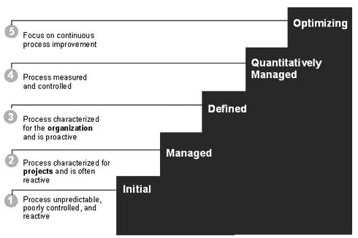

Slide 17
The specific goals (SG) and the associated specific practices(SP) defined for project planning are
SG 1 Establish estimates
SP 1.1 Estimate the scope of the project
SP 1.2 Establish estimates of work product and task attributes
SP 1.3 Define project life cycle
SP 1.4 Determine estimates of effort and cost
SG 2 Develop a Project Plan
SP 2.1 Establish the budget and schedule
SP 2.2 Identify project risks
SP 2.3 Plan for data management
SP 2.4 Plan for needed knowledge and skills
SP 2.5 Plan stakeholder involvement
SP 2.6 Establish the project plan
SG 3 Obtain commitment to the plan
SP 3.1 Review plans that affect the project
SP 3.2 Reconcile work and resource levels
SP 3.3 Obtain plan commitment

Slide 18
In addition to specific goals and practices, the CMMI also defines a set of five generic goals and related practices for each process area.
Each of the five generic goals corresponds to one of the five capability levels.
GG 1 Achieve specific goals
GP 1.1 Perform base practices
GG 2 Institutionalize a managed process
GP 2.1 Establish and organizational policy
GP 2.2 Plan the process
GP 2.3 Provide resources
GP 2.4 Assign responsibility
GP 2.5 Train people
GP 2.6 Manage configurations
GP 2.7 Identify and involve relevant stakeholders
GP 2.8 Monitor and control the process
GP 2.9 Objectively evaluate adherence
GP 2.10 Review status with higher level management

Slide 19
GG 3 Institutionalize a defined process
GP 3.1 Establish a defined process
GP 3.2 Collect improvement information
GG 4 Institutionalize a quantitatively managed process
GP 4.1 Establish quantitative objectives for the process
GP 4.2 Stabilize sub process performance
GG 5 Institutionalize and optimizing process
GP 5.1 Ensure continuous process improvement
GP 5.2 Correct root causes of problems
PROCESS PATTERNS:
The software process can be defined as a collection patterns that defines a set of activities, actions, work tasks, work products and/or related behaviors required to develop computer software.
provides us with a template - a consistent method for describing an important characteristic of the software process.

Slide 20
A pattern might be used to describe a complete process and a task within a framework activity.
Pattern Name
Intent
Type: 3 types
Task patterns define a software engineering action or work task that is part of the process and relevant to successful software engineering practice.
Example: Requirement Gathering
Stage Patterns define a framework activity for the process. This pattern incorporates multiple task patterns that are relevant to the stage.
Example: Communication
Phase patterns define the sequence of framework activities that occur with the process, even when the overall flow of activities is iterative in nature.
Example: Spiral model or prototyping.
Initial Context
Problem
Solution
Resulting Context
Known Uses

Slide 21
PROCESS ASSESSMENT
the process itself should be assessed to be essential to ensure that it meets a set of basic process criteria that have been shown to be essential for a successful software engineering.
Number of different approaches to software process assessment have been proposed ,
Standards CMMI Assessment Method for Process Improvement (SCAMPI)
CMM Based Appraisal for Internal Process Improvement (CBA IPI)
SPICE (ISO/IEC15504)
ISO 9001:2000 for Software.

Slide 22
DAY-3

Slide 23
PROCESS MODELS
PRESCRIPTIVE MODELS:
Prescriptive process models define a set of activities, actions, tasks, milestones, and work products that are required to engineer high-quality software.
These process models are not perfect, but they do provide a useful roadmap for software engineering work.
Software Development Life Cycle (SDLC) is a process used by the software industry to design, develop and test high quality software.

Slide 24
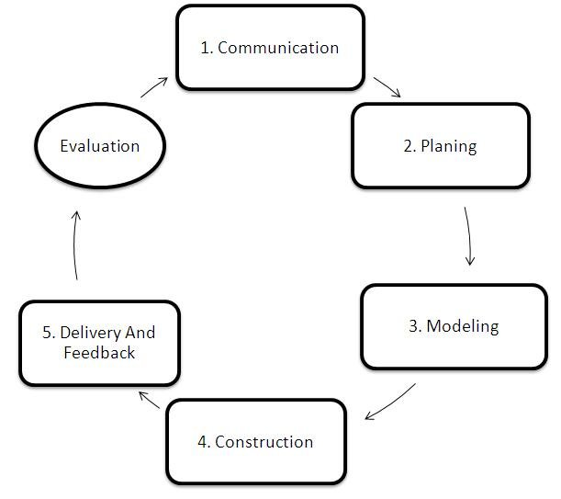
SDLC phases

Slide 25
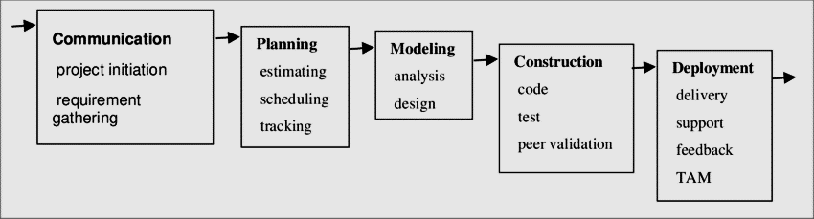
THE WATERFALL MODEL:
sometimes called the classic life cycle, suggests a systematic sequential approach.
Adv:
Useful process model where requirements are fixed and work is to proceed to complete in a linear manner.
Disadv:
Changes can cause confusion as the project team proceeds.
It is often difficult for the customer to state all requirements explicitly.
A working version of the programs will not be available until late in the project time-span.

Slide 26
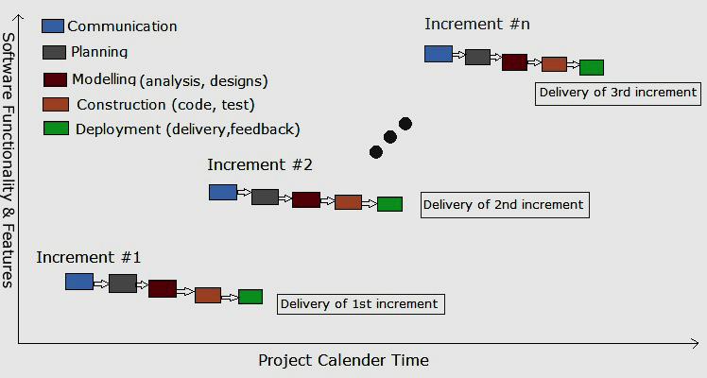
INCREMENTAL PROCESS MODELS:
The incremental model
The RAD model
THE INCREMENTAL MODEL:
Incremental development is particularly useful when staffing is unavailable for a complete implementation by the business deadline that has been established for the project.

Slide 27
DAY-4

Slide 28
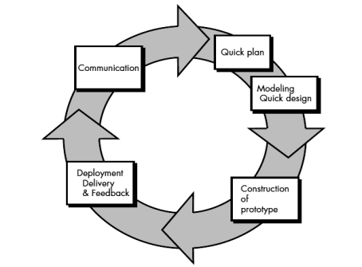
EVOLUTIONARY PROCESS MODELS:
PROTOTYPING:
Can be implemented within the context of anyone of the process model.
Prototyping iteration is planned quickly and modeling occurs. The quick design leads to the construction of a prototype. The prototype is deployed and then evaluated by the customer/user.

Slide 29
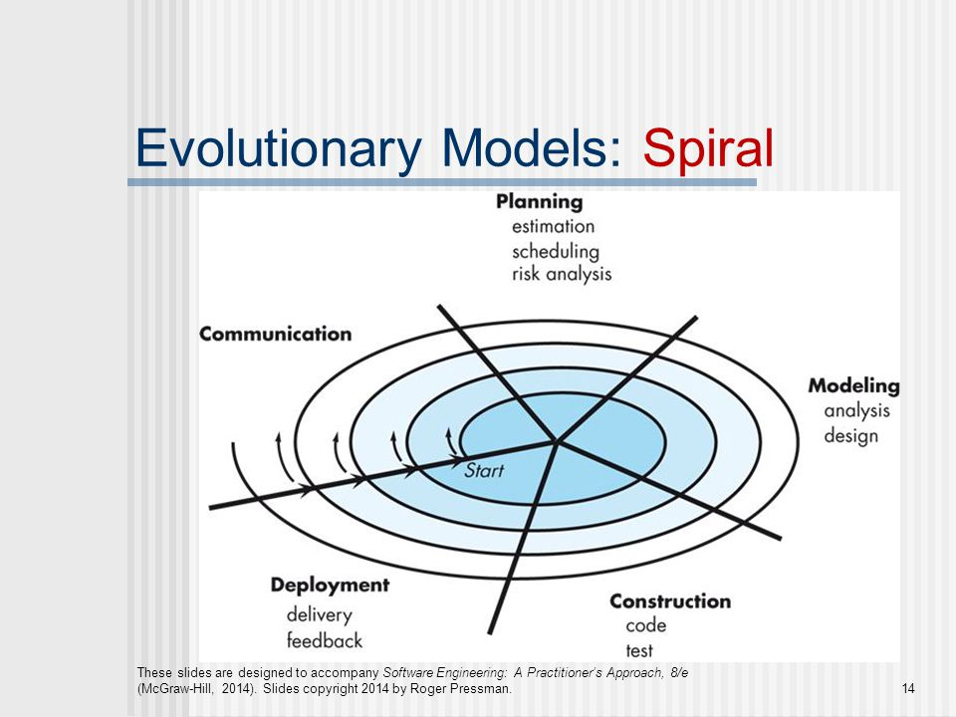
THE SPIRAL MODEL
Couples the iterative nature of prototyping with the controlled and systematic aspects of the waterfall model.
ASdapted to apply throughout the entire life cycle of an application, from concept development to maintenance.

Slide 30
THE UNIFIED PROCESS:
Implements many of the best principles of agile software development.
Recognizes the importance of customer communication and streamlined methods for describing the customer’s view of a system.
PHASES OF THE UNIFIED PROCESS:
The inception phase - encompasses both customer communication and planning activities.
The elaboration phase - encompasses the customer communication and modeling activities of the generic process model.
The construction phase - identical to the construction activity defined for the generic software process.
The transition phase - encompasses the latter stages of the generic construction activity and the first part of the generic deployment activity.
The production phase - coincides with the deployment activity of the generic process.

Slide 32
DAY-5

Slide 33
PERSONAL AND TEAM PROCESS MODELS:
Each software engineer would create a process that best fits his or her needs, and at the same time meets the broader needs of the team and the organization.
Personal software process (PSP)
emphasizes personal measurement of both the work product that is produced and the resultant quality of the work product.
The PSP process model defines five framework activities
Planning: This activity isolates requirements and all the metrics are recorded on worksheets or templates. Finally, development tasks are identified and a project schedule is created.
High level design: External specifications for each component to be constructed are developed and a component design is created. All issues are recorded and tracked.
High level design review: Formal verification methods are applied to uncover errors in the design.
Development: The component level design is refined and reviewed. Code is generated, reviewed, compiled, and tested.
Postmortem: Using the measures and metrics collected the effectiveness of the process is determined.

Slide 34
Team software process (TSP)
The goal of TSP is to build a “self-directed project team that organizes itself to produce high-quality software.
Humphrey defines the following objectives for TSP:
Build self-directed teams that plan and track their work, establish goals, and own their processes and plans. These can be pure software teams or integrated product teams (IPTs) of 3 to about 20 engineers.
Show managers how to coach and motivate their teams and how to help them sustain peak performance.
Accelerate software process improvement by making CMM Level 5 behavior normal and expected.
Provide improvement guidance to high-maturity organizations.
Facilitate university teaching of industrial-grade team skills.
TSP defines the following framework activities:
launch
high-level design
implementation
integration and test
postmortem.

Slide 35
Process Technology:
The tools have been developed to help software organizations to
analyze their current process,
organize work tasks,
control and monitor progress,
and manage technical quality
Process technology tools allow a software organization to build an automated model of the process framework, task sets, and umbrella activities

